Slide 1

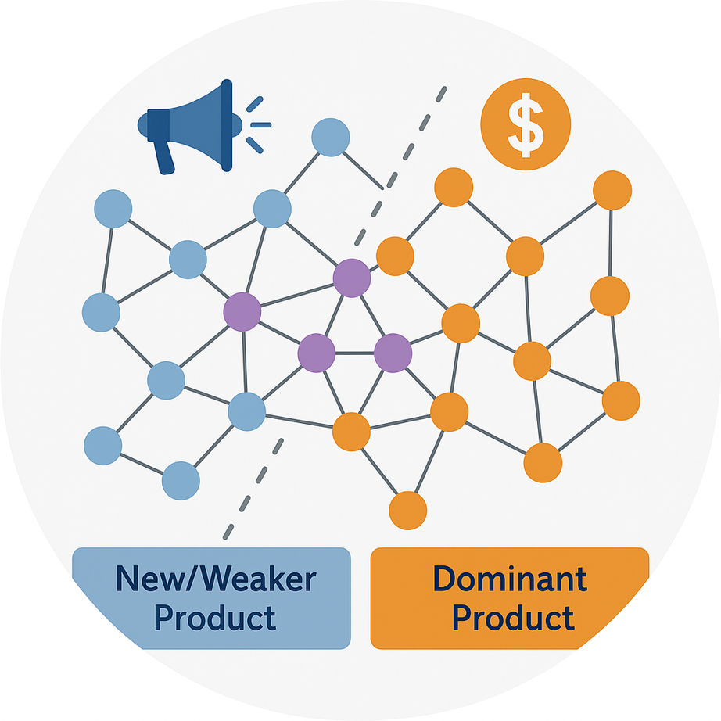
Shailaja Mallick
Vishwaraj Doshi
Do Young Eun
Keeping Up with the Winner!
TARGETED ADVERTISEMENT TO COMMUNITIES IN SOCIAL NETWORKS
Presented by
Shivam Kumar Goyal
Lakshay

Slide 2
Essence of the Study
Abstract
Objective
When a new product enters a market already dominated by another, it often struggles to survive.
Traditional research shows that on the same network of users, the stronger product dominates and eliminates the weaker one.
This paper explores how a new or weaker product can coexist with a dominant competitor by:
Identifying optimal target users for advertisement
Operating under a limited marketing budget
Approach
Results
The system is modeled using the bi-SIS (Susceptible–Infected–Susceptible) epidemic model.
A perturbation-based method is applied to determine the best set of users to target for maximum influence.
Simulations on real-world social network datasets show that:
The new product can achieve a positive market share
Even under the same budget, it can survive and coexist with the stronger product.

Slide 3
Table of contents
1.
Introduction & Motivation
2.
Related Work & Modeling Approach
3.
System Model
4.
Dynamic Model (bi-SIS Equations)
5.
Problem Setup
6.
Analysis of Product 2’s Market Share
7.
Sensitivity Analysis
8.
Experimental Setup & Results
9.
Conclusion & Broader Impact

Slide 4


Introduction
In today’s fast-paced and highly competitive markets, one of the key challenges for any company launching a new product is how to position and market it effectively.
A new product can differentiate itself through unique design, brand image, or niche positioning, and reach consumers using targeted advertisements rather than expensive mass campaigns.
Research shows that focusing on small, well-connected communities of users — who further influence their social networks — can be far more effective for sustained growth than targeting the entire population

Slide 5

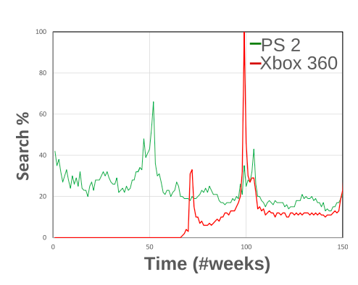
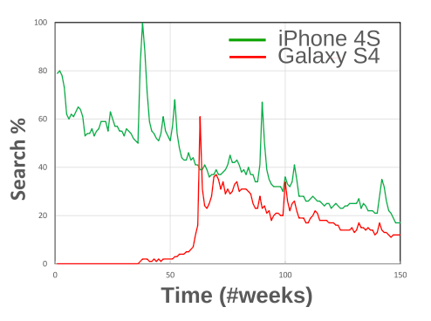
real life examples
Xbox vs. PlayStation
Galaxy S4 vs. iPhone 4S:
Despite PlayStation’s dominance, Microsoft’s Xbox sustained its presence by cultivating a strong gamer community and personalized engagement strategies.
In a smartphone market largely led by Apple, Samsung’s Galaxy S4 gained traction through community-based marketing and social media advocacy, establishing a solid foothold over time

Slide 6




Opinion
Dynamics Models
Epidemic Models (SIS, SIR, etc.)
Existing Modeling Frameworks
Capture opinion formation & convergence through iterative neighbor averaging.
Treat adoption as infection spread; nodes switch between susceptible/infected.
Cannot represent adoption/dropping dynamics or true competition.
Handles only one product; it must be extended to model competition
Gaps in Existing Work
Focus mainly on which product wins, not how much market share each gets.
Assume fixed influence or one-time adoption, ignoring changing user choices.
Fail to capture coexistence seen in real markets.
Linear Threshold / Information Cascade Models
Individuals activate (adopt) once neighbor influence crosses a threshold.
Activation is one-way; individuals don’t switch states back and forth.

Slide 7

Modeling Approach — Bi-SIS Framework
Why bi-SIS?
Core Model
Our Extension
It allows users to:
Adopt one product,
Drop it and become susceptible again,
Adopt the other product later.
This captures real-world switching behavior and competition between alternatives
ẋᵢ = β₁(1 − xᵢ − yᵢ) Σⱼ aᵢⱼxⱼ − δ₁xᵢ
ẏᵢ = β₂(1 − xᵢ − yᵢ) Σⱼ aᵢⱼyⱼ − δ₂yᵢ
Add targeted community formation among selected users
Apply budget and user-cost constraints
Find optimal user-targeting strategies to maximize Product 2’s market share
Validate through real-network simulations (Facebook datasets)
💡 Intuition
Product 1 spreads through the original network A, with rate B1 and drops down the product with delta 1
Product 2 spreads through A ,with rate B2 and drops down the product with delta 2

Slide 8
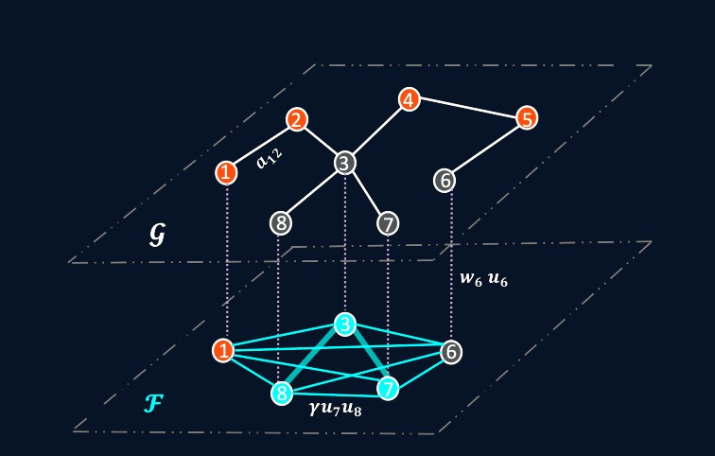

System ModeL
Objective
To maximize the long-term market share of a new (weaker) product
by targeting specific users and recruiting them into a community that amplifies product influence.
Network Setup
The market is represented as a social graph G(N, E):
Nodes (N): users
Edges (E): social connections (friendship, information exchange)
Product 1 = dominant product (already popular)
Product 2 = new / weaker product entering the same network
Community Formation
The company creates a community (layer F) — an online forum, subreddit, or influencer group -where users actively discuss Product 2.
Each user i participates with probability u_i.
Any two participating users i, j influence each other with additional weight γu_i u_j.

Slide 9
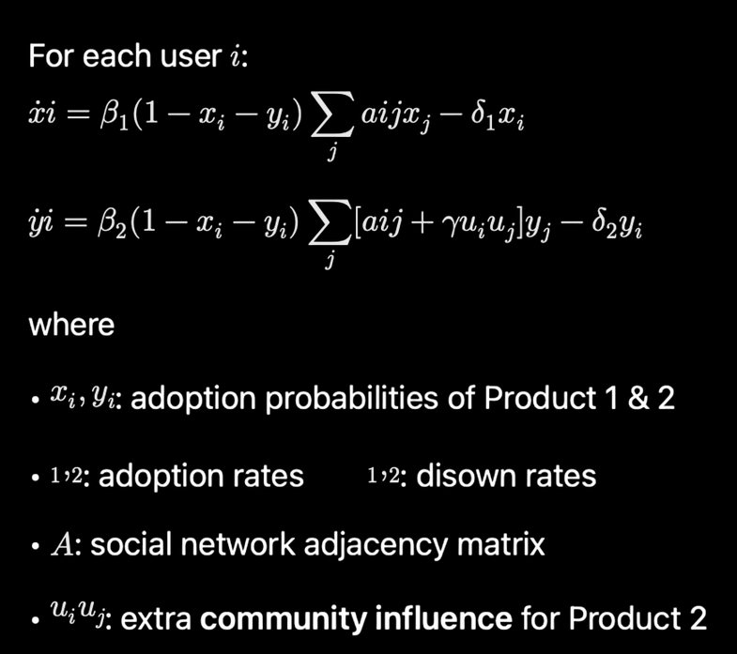
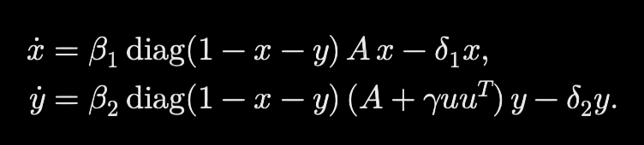
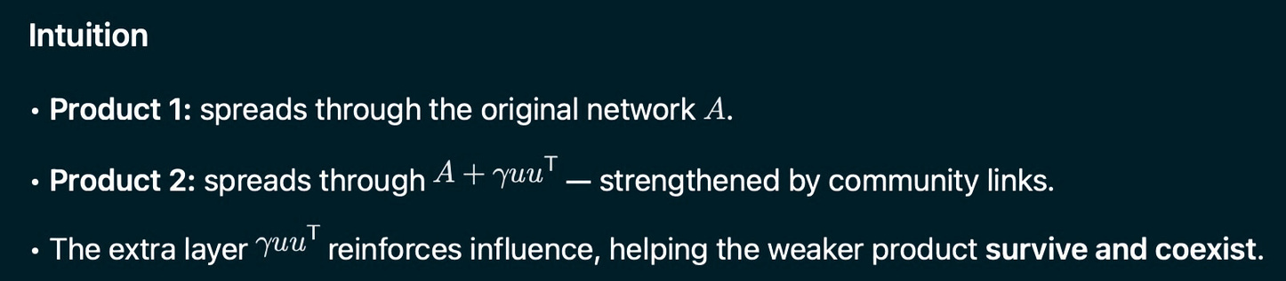
bi-SIS System Equations
Competing products spread in a social network G(N,E) with adjacency matrix A.
Each user i can be:
Product 1 user (xᵢ),
Product 2 user (yᵢ)
Susceptible (1 − xᵢ − yᵢ).
System Equation
In matrix form
[How]?

Slide 10
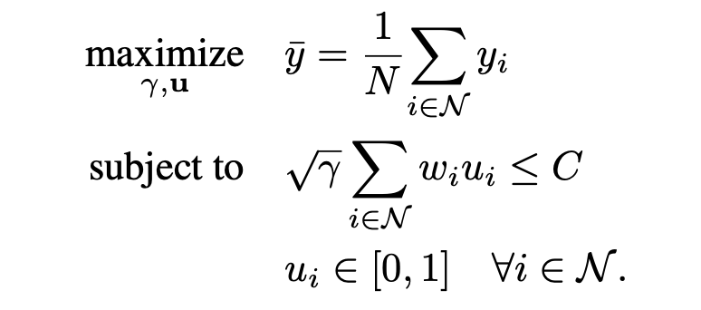
Problem Setup
Key Idea
The company must optimally divide its budget between:
• Recruiting users (increasing participation u_i), and
• Improving communication (raising γ)
to maximize Product 2’s market share against the dominant Product 1.
Objective
Maximize the steady-state market share of the new (weaker) product Product 2 under a limited marketing budget C.
Why √γ in the Constraint
• Keeps scaling between γ and u consistent in A + γuu^T.
• If u is scaled by constant c, setting γ’ = γ / c^2 leaves γuu^T unchanged.
• Allows flexible budget allocation between recruitment (u) and influence (γ) without changing results.

Slide 11
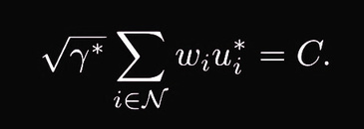
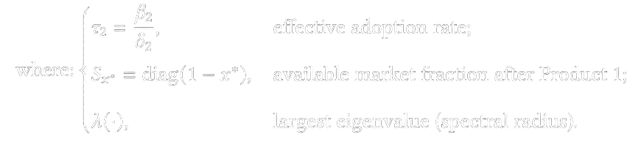
Analysis of Product 2’s Market Share (𝑦̄)
Objective
Proposition 1 - Budget Utilization
To analyze:
The minimum budget needed for Product 2 to achieve a positive steady-state market share
(𝑦̄ > 0)
How changes in user engagement (uᵢ) affect the market share under a fixed budget.
The optimal market share is achieved only when the entire budget is used.
Follows from the system’s monotonicity:
𝑦̄ increases with both γ (communication strength) and u (user participation).
Survival Condition
Takeaway
The new product’s success depends jointly on:
Available market space (1 – x*),
Community strength (γ), and
User participation (u)
all optimized within the total budget C.
[How?]

Slide 12

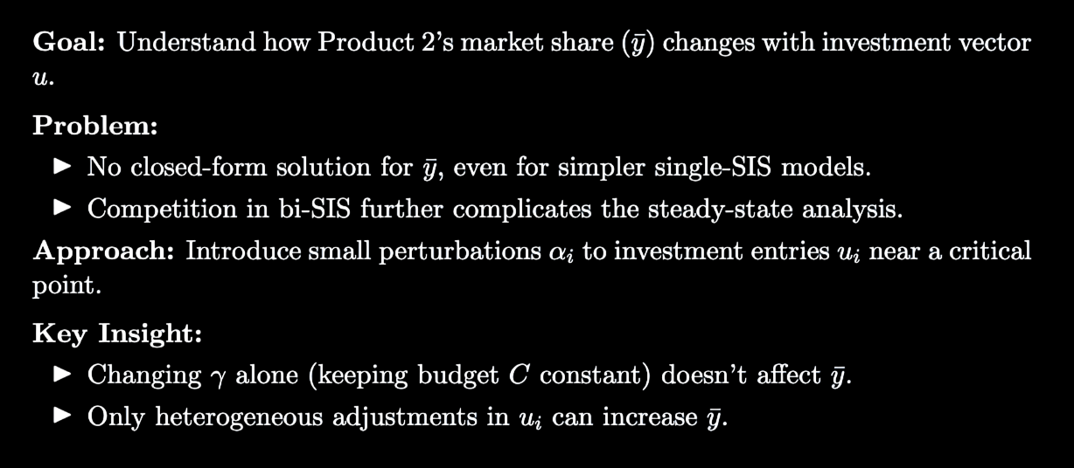
The Challenge: Estimating Product 2’s Market Share

Slide 13
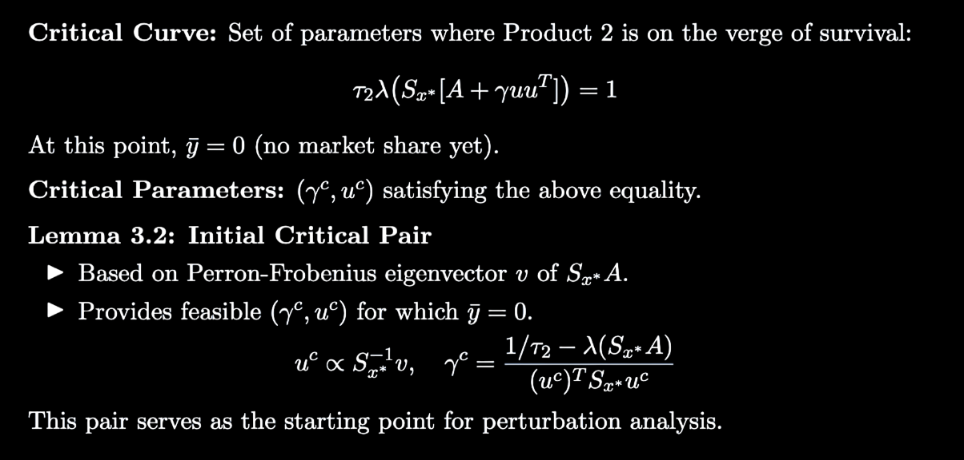
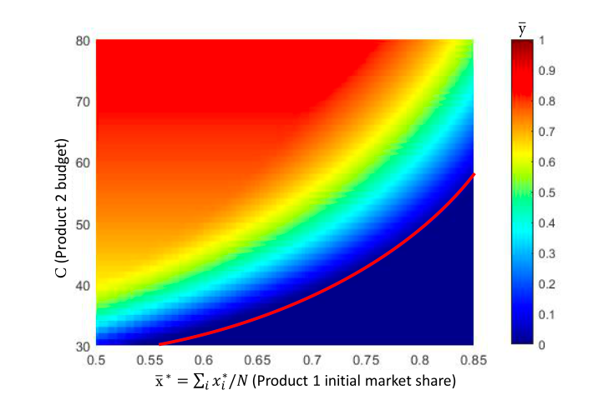
Critical Parameters

Slide 14
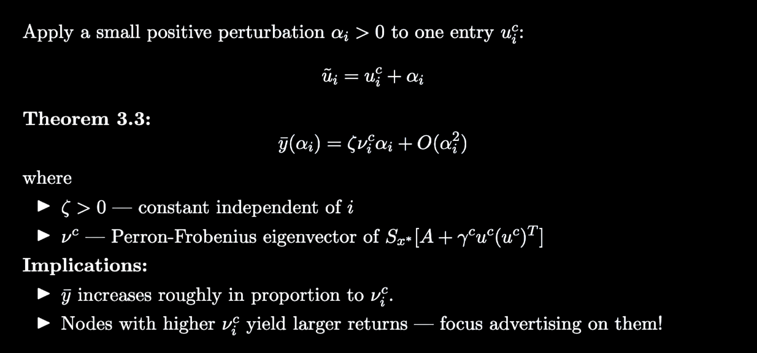
Sensitivity Analysis
[How?]

Slide 15
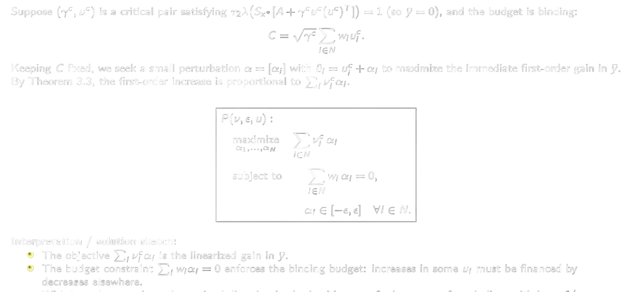
New objective function

Slide 16
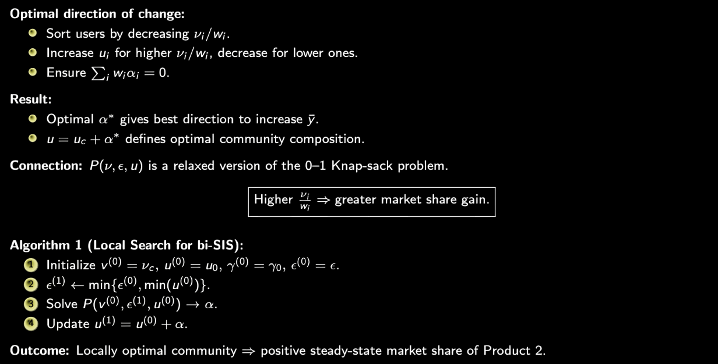
Finding Optimal solution

Slide 17

Experiments
Objective:
Test if the proposed Local Search Algorithm (Algorithm 1) helps the weaker Product 2 survive against the stronger Product 1.
What’s being measured:
Improvement in the survival threshold — how well Product 2 sustains itself in the network.
Setup:
Start with critical parameters from theory (μc,uc).
Compare Algorithm 1’s performance against common baseline methods.
Think of it as:
“Does our smart targeting strategy really work better than traditional influence-based ones?”

Slide 18

Simulation Setup
Datasets Used (Real Social Networks):
Facebook Social Circles — 4,039 nodes, 88,234 edges
Facebook Public Figures — 11,565 nodes, 67,000 edges
Why these?
They represent real-world social connections where ideas or products spread naturally.
Product Strength Setup:
➡️ Product 1 starts dominant.
➡️ Product 2 starts almost extinct.
Dataset | Product 1 (Strong) | Product 2 (Weak)
Facebook (4k) | τ₁ = 0.8 | τ₂ = 0.05
Facebook (12k) | τ₁ = 0.4 | τ₂ = 0.03

Slide 19
Budget & Market Share Metrics
Budget Scenarios:
💵 Homogeneous Cost: Each user costs the same (wᵢ = 1).
💸 Heterogeneous Cost: Each user’s cost varies randomly.
Goal: Use the entire budget (C) efficiently to recruit users.
Market Share Metrics:
AvgY (𝑦̄): Product 2’s share (new product)
AvgX (𝑥̄): Product 1’s share (existing product)
Simulated for 1000 time steps to see steady-state behavior.

Slide 20
Competing Baseline Methods
What Algorithm 1 is competing against:
Why these?
They’re the standard influencer-based strategies — logical but not always optimal.
Budget Allocation:
All methods use the same total budget C, but distribute costs differently based on node importance.
Method | Concept
Degree Centrality | Target the most connected users (popular ones).
Eigenvector Centrality (EVC) | Target users connected to other important users.
NetShield Algorithm | Usually for immunization, adapted here for influence spread.

Slide 21
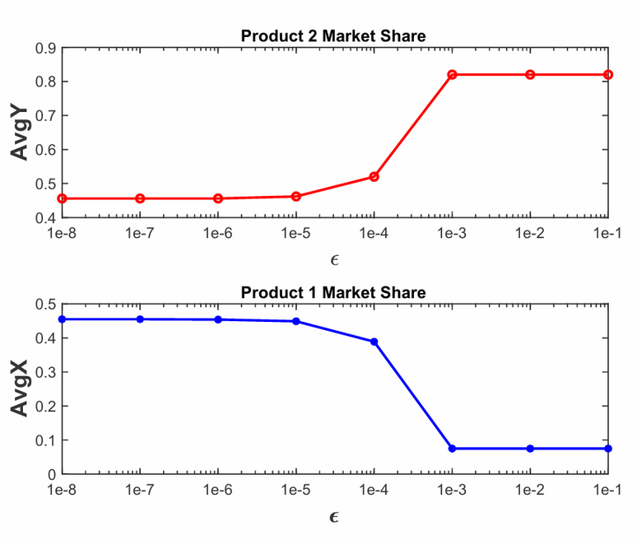
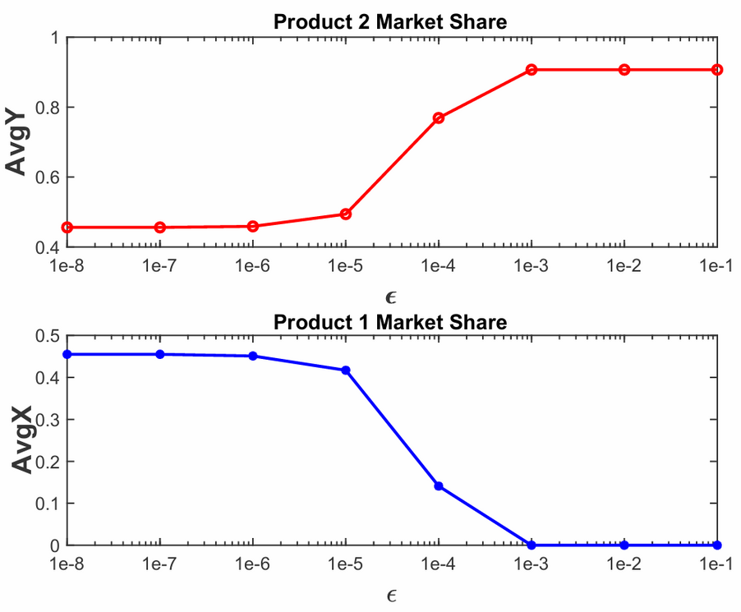
Figures:
Facebook Social Circles
Figure4: Facebook (≈4k nodes): Change in AvgY and AvgX for Homogeneously distributed cost and different values of ϵ.
Figure5: Facebook (≈4k nodes): Change in AvgY and AvgX for Heterogeneously distributed cost and different values of ϵ.

Slide 22
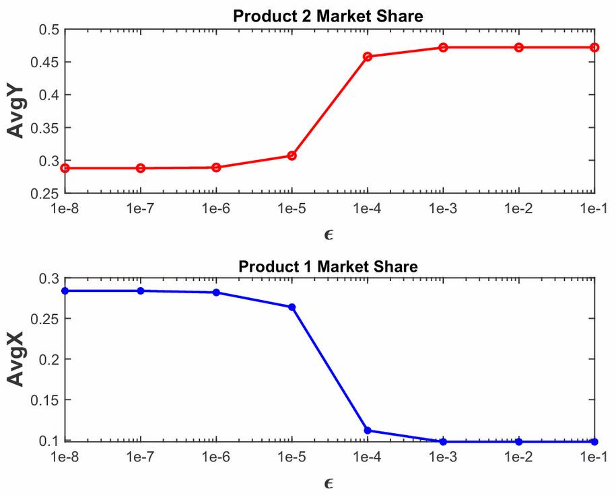
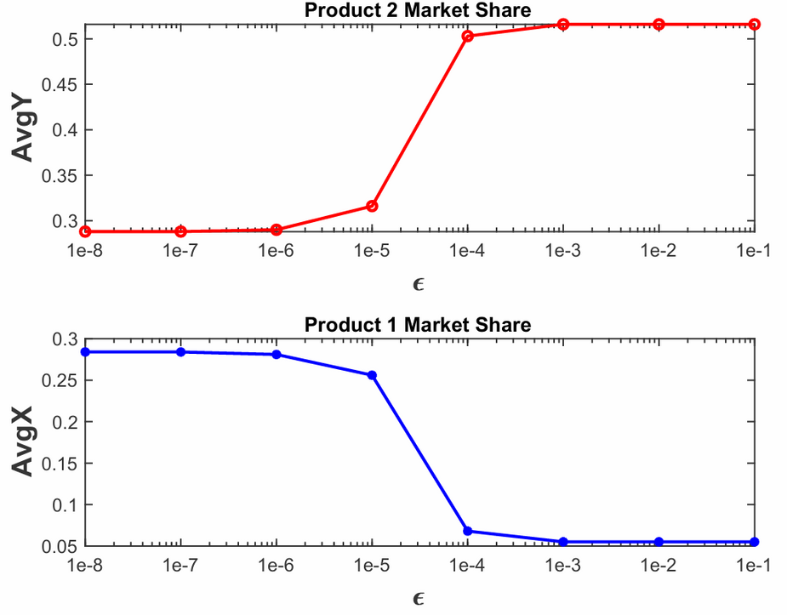
Figures:
Facebook Public Figures
Figure6: Facebook (≈12k nodes): Change in AvgY and AvgX for Homogeneously distributed cost and different values of ϵ.
Figure7: Facebook (≈12k nodes): Change in AvgY and AvgX for Heterogeneously distributed cost and different values of ϵ.

Slide 23
Result 1
What is ε?
A small tweak size that controls how much we can adjust user participation (uᵢ).
Observation (from Figures 4–7):
✅ As ε increases, Product 2’s market share (AvgY) rises.
❌ Meanwhile, Product 1’s share (AvgX) drops.
Why it matters:
Larger ε → more flexible targeting → stronger Product 2 presence.
Key Insight:
Allowing slightly bigger adjustments helps Product 2 reach more users faster.

Slide 24
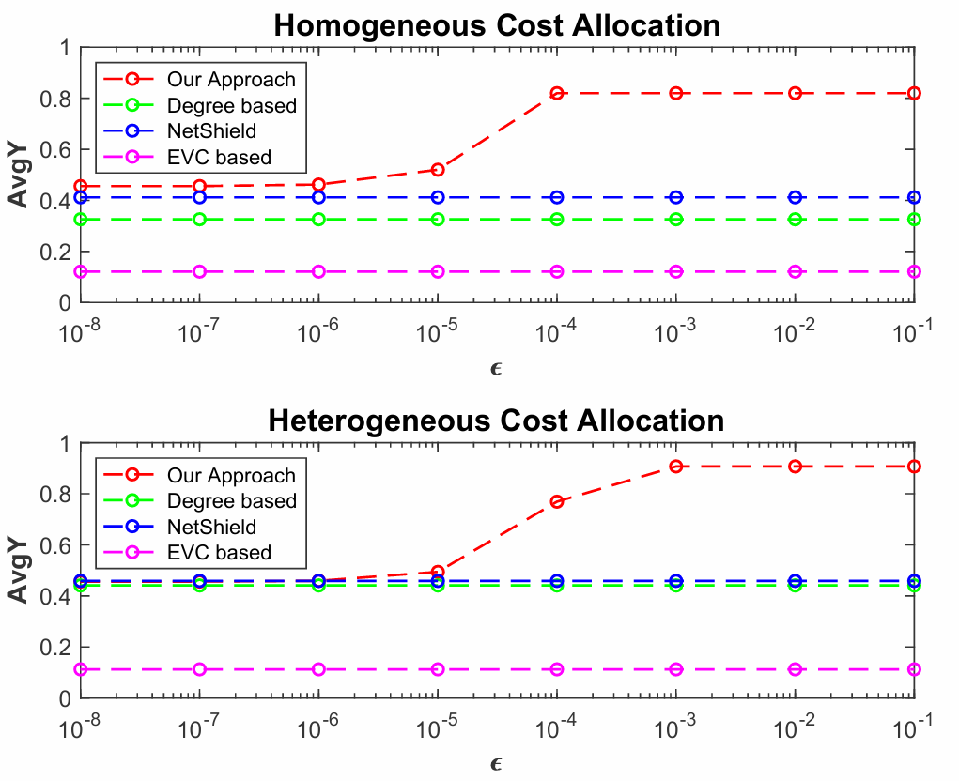
Figure:
Baseline Comparisons
Figure8: Facebook (≈4k nodes): Change in AvgY for Homogeneously & Heterogeneously distributed cost against Degree-based, Eigenvector-based centrality measure, & NetShield Algorithm.

Slide 25
Result 2
The proposed algorithm outperforms all baselines across both cost settings.
Takeaway for Marketers:
Don’t just spend on the most famous users!
Smart, community-based targeting = better market share and survival.
Final Insight:
“Influence ≠ Effectiveness. The right users, not just popular ones, decide success.”
Cost Type | Outcome
Homogeneous | Our algorithm gets higher AvgY than all others.
Heterogeneous | Still wins — consistent across random costs.

Slide 26
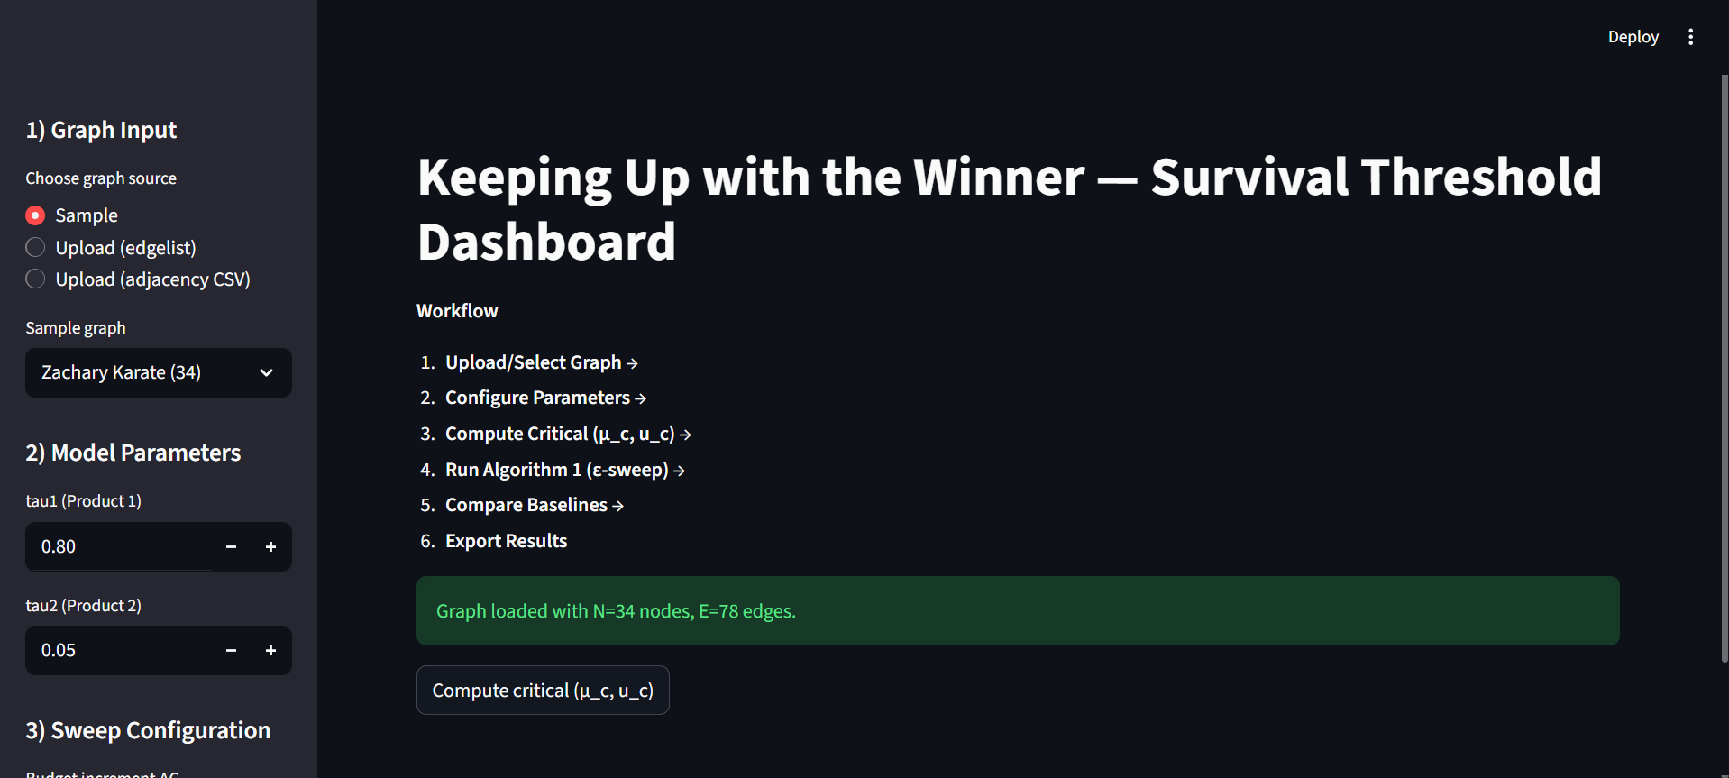

Implementation Overview — “Keeping Up with the Winner”
Key Features
Implements bi-SIS dynamics for two competing products
Algorithm 1: Local perturbation search for optimal targeting
Baseline comparisons: Degree, Eigenvector, and NetShield
Multiple cost schemes: Homogeneous, degree-based, eigenvector-based
Budget & Epsilon sweeps: Market share vs. budget analysis
Interactive Streamlit Dashboard for real-time visualization
Reproducible experiments matching figures from the original paper
“From paper to practice — turning theory into an interactive, reproducible system for strategic marketing in networks.”
Github

Slide 27
Conclusion
Our Goal:
Develop an algorithm to find the optimal set of users (µ, u) who, when targeted under a given budget, help a new/weaker product (Product 2) gain a positive market share against a dominant product.
How We Did It:
Introduced a perturbation-based approach to identify users who can be effectively influenced.
Tested on real-world Facebook network datasets.
Compared with standard methods: Degree Centrality, Eigenvector Centrality, and NetShield Algorithm.
Results:
Our approach outperforms all baselines, regardless of whether the budget is distributed uniformly or randomly.
Demonstrated that targeting niche, well-connected communities is more effective than focusing on popular influencers.
Validated using the bi-SIS epidemic model and extensive simulations, proving consistent performance improvement.
Key Takeaway:
Smart, data-driven community targeting ensures the survival and growth of new products — even in competitive markets.

Slide 28
Broader Impact
Managerial Relevance
Practical Implications
Provides brand managers with a data-driven framework for budget-efficient marketing.
Helps in targeting niche communities rather than expensive, popular influencers.
Aligns with real-world marketing on platforms like Instagram and Facebook, where brands reach audiences through micro-influencers.
Shows that spending smart (on the right users) is better than spending more.
The identified community-based targeting ensures a higher market share and better ROI.
Demonstrates that even with partial network knowledge, firms can still find and engage key users.
“Influence isn’t about fame — it’s about connecting with the right communities that keep your product alive.”

Slide 29

Thank you

Slide 30
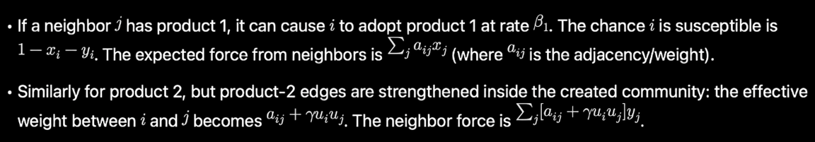
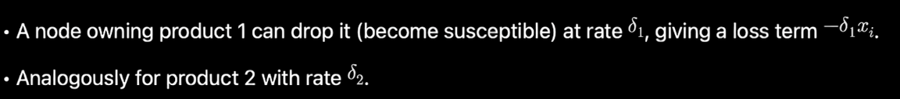
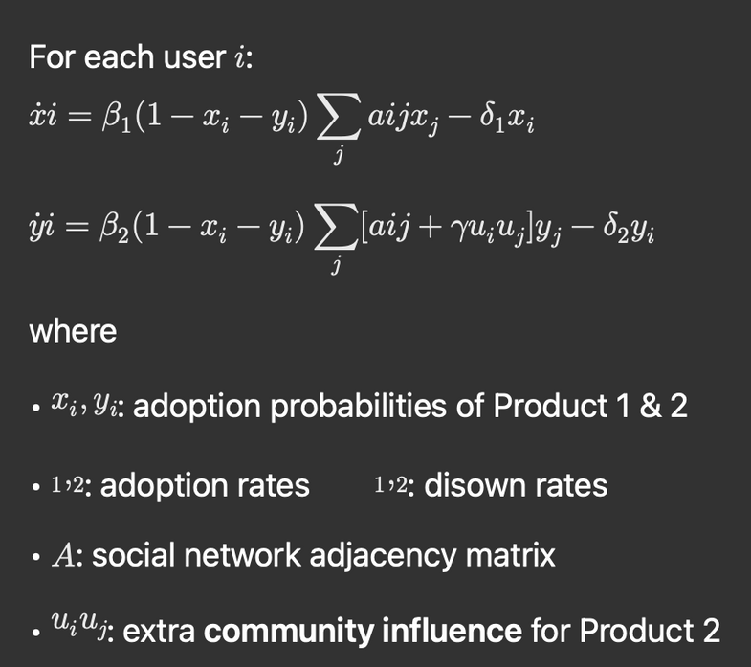


Bi-Sis equation derivation
State probabilities for node i at time t:
x_i(t) = prob. node i has product 1,
y_i(t) = prob. node i has product 2,
so the prob. node i is susceptible (neither product) is (1-x_i-y_i).
There are two possibilities which changes this probability-
Infection / adoption from neighbors
Recovery / disown
Infection of i by the neighbour
having product 1
disown
product 1
disown
product 2
Infection of i by the neighbour
having product 2
Back to Slide

Slide 31
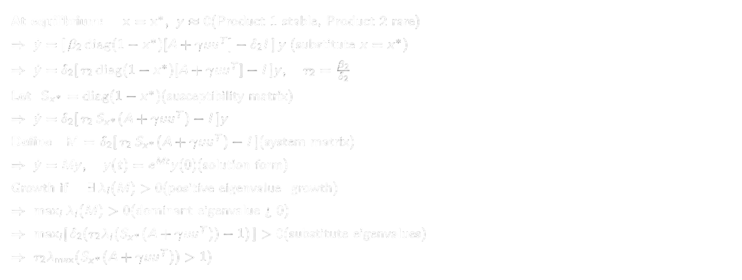

Survival Condition of product 2 -
Survival condition
Back to Slide

Slide 32
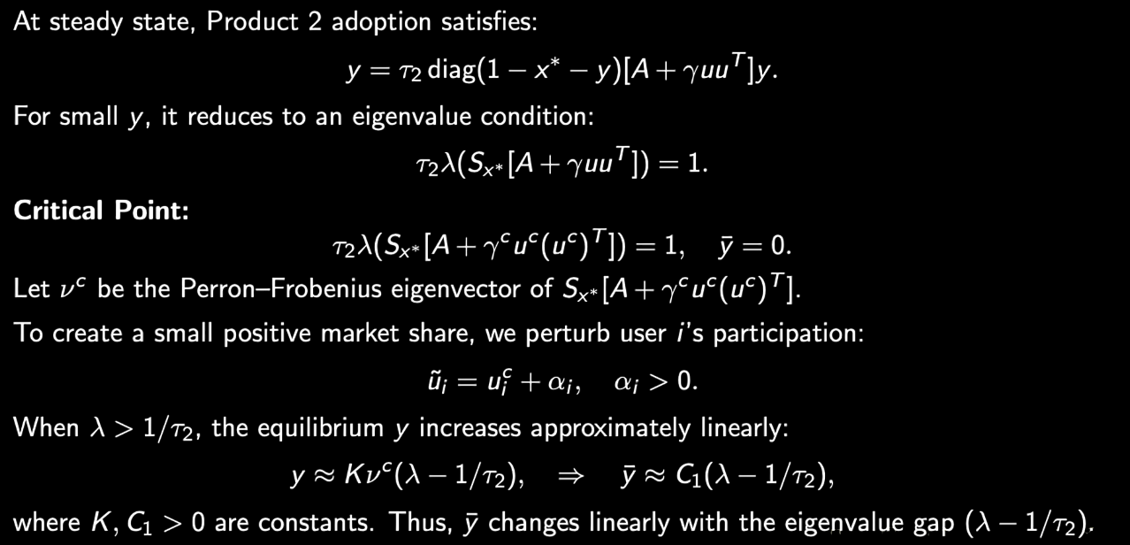
Proof of theorem 3.3

Slide 33
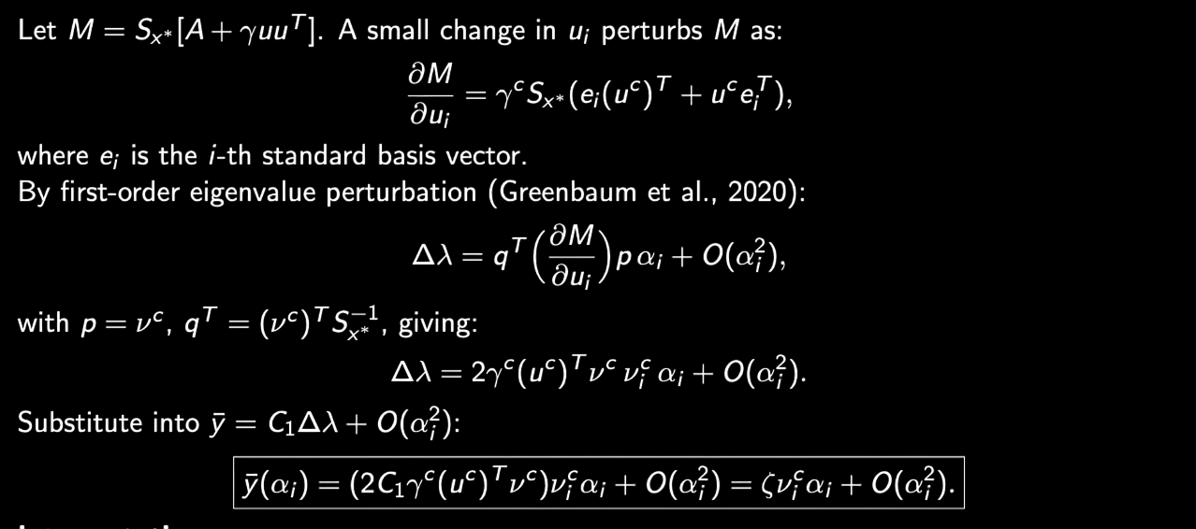
Proof of theorem 3.3
Back to Slide

